Slide 1


Emma Enrollment module management assistant
A smart chat bot assisting courses enrollment

Slide 2


Courses enrollment is crucial to student performance, but they are doing it without help

Slide 3
Enrollment strategy is important
1
It retains
4
Somethings in term of $ and time
Reduce class-dropping
2
It saves time
Complete degree in the shortest timeline
3
It improves
Class timing [], strategy [], settings [] leads to better GPA

Slide 4
What is EMMA?
Enrollment
Machine-learned recommendation system
Modules
Provide flexible and most optimized strategy
Management
Provide comprehensive view of student’s profile and capability
Assistant
Generative-AI chat bot integrated into enrollment process

Slide 5

Literature Review & Market Research
Enrollment strategy
LLM
Recommedation
asd
asdf
asdf

Slide 6
Development cycle
PLANNING
User analysis
PROTOTYPING
Collect data
USER TESTING
Questionnaire design
DEVELOPING
Adjustments
LAUNCH
Deploy
Literature review
Specifications
Data mining
Components testing
Conduct survey
Result analysis
More testing
1
2
3
4
5

Slide 7

Challenges & limitations
A1
A2
asdf
asdf

Slide 8
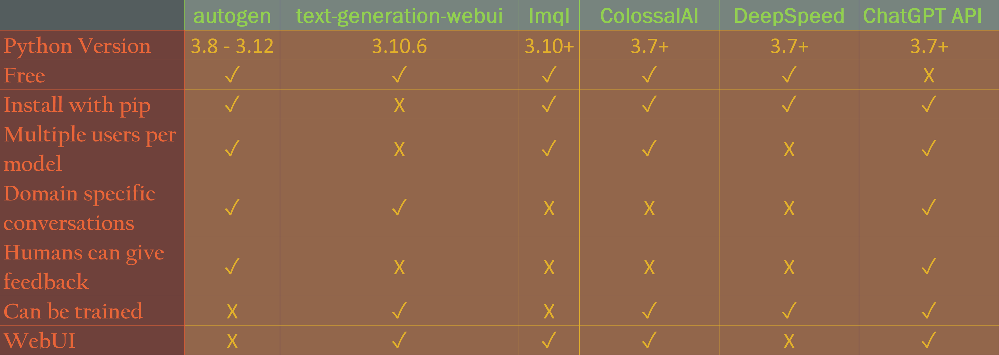
LLMs Pros and Cons
https://github.com/microsoft/autogen
https://github.com/oobabooga/text-generation-webui
https://github.com/eth-sri/lmql
https://github.com/hpcaitech/ColossalAI
https://github.com/microsoft/DeepSpeed
https://openai.com/product#made-for-developers

Slide 9



agenda
Introduction​
Primary goals​
Areas of growth​
Timeline​
Summary​

Slide 10


Introduction
At Contoso, we empower organizations to foster collaborative thinking to further drive workplace innovation. By closing the loop and leveraging agile frameworks, we help business grow organically and foster a consumer first mindset.​

Slide 11


Primary goals
Click to add photo
Annual Revenue Growth

Slide 12
Quarterly performance

Slide 13

Areas of growth
 | B2B | Supply chain | ROI | E-commerce
Q1 | 4.5 | 2.3 | 1.7 | 5.0
Q2 | 3.2 | 5.1 | 4.4 | 3.0
Q3 | 2.1 | 1.7 | 2.5 | 2.8
Q4 | 4.5 | 2.2 | 1.7 | 7.0

Slide 14

Business opportunities are like buses. There's always another one coming.​
Richard Branson

Slide 15




Meet the team
Takuma Hayashi​
Mirjam Nilsson​
Flora Berggren​
Rajesh Santoshi​
President
Chief Executive Officer
Chief Operations Officer
VP Marketing

Slide 16








Meet the team
Takuma Hayashi
Mirjam Nilsson​
Flora Berggren​
Rajesh Santoshi​
President
Chief Executive Officer
Chief Operations Officer
VP Marketing
Graham Barnes
Rowan Murphy
Elizabeth Moore
Robin Kline
VP Product
SEO Strategist
Product Designer
Content Developer

Slide 17
Plan for product launch
1
Planning
4
Strategy
Synergize scalable e-commerce
Foster holistically superior methodologies
2
Marketing
5
Design
Disseminate standardized metrics
Coordinate e-business applications
3
Launch
Deploy strategic networks with compelling e-business needs

Slide 18
Timeline
Sep 20XX
Synergize scalable
e-commerce
Nov 20XX
Disseminate standardized metrics
Jan 20XX
Coordinate e-business applications
Mar 20XX
May 20XX
Foster holistically superior methodologies
Deploy strategic networks with compelling
e-business needs

Slide 19
Areas of focus
B2B market scenarios​
Cloud-based opportunities​
Develop winning strategies to keep ahead of the competition​
Capitalize on low hanging fruit to identify a ballpark value​
Visualize customer directed convergence​
Iterative approaches to corporate strategy​
Establish a management framework from the inside​

Slide 20
How we get there
ROI
Niche markets​
Supply Chains
Envision multimedia-based expertise and cross-media growth strategies​
Visualize quality intellectual capital​
Engage worldwide methodologies with web-enabled technologies​
Pursue scalable customer service through sustainable strategies​
Engage top-line web services with cutting-edge deliverables​
Cultivate one-to-one customer service with robust ideas​
Maximize timely deliverables for real-time schemas​

Slide 21


Summary
At Contoso, we believe in giving 110%. By using our next-generation data architecture, we help organizations virtually manage agile workflows. We thrive because of our market knowledge and great team behind our product. As our CEO says, "Efficiencies will come from proactively transforming how we do business."​

Slide 22

Thank you
Mirjam Nilsson​​
mirjam@contoso.com​
www.contoso.com​

Slide 23

Presentation title
Mirjam Nilsson​

Slide 24

Agenda
Introduction
Primary goals
Areas of growth
Timeline
Summary

Slide 25

Introduction
At Contoso, we empower organizations to foster collaborative thinking to further drive workplace innovation. By closing the loop and leveraging agile frameworks, we help businesses grow organically and foster a consumer-first mindset.

Slide 26

Primary Goals
Annual revenue growth

Slide 27
Quarterly performance

Slide 28
Areas of growth
 | B2B | Supply chain | ROI | E-commerce
Q1 | 4.5 | 2.3 | 1.7 | 5.0
Q2 | 3.2 | 5.1 | 4.4 | 3.0
Q3 | 2.1 | 1.7 | 2.5 | 2.8
Q4 | 4.5 | 2.2 | 1.7 | 7.0

Slide 29
Business opportunities are like buses. There's always another one coming.
Richard Branson

Slide 30




Meet our team
Takuma Hayashi​
Mirjam Nilsson​
Flora Berggren​
Rajesh Santoshi​
President
Chief Executive Officer
Chief Operations Officer
VP Marketing

Slide 31








Meet our extended team
Takuma Hayashi​
Mirjam Nilsson​
Flora Berggren​
Rajesh Santoshi​
President
Chief Executive Officer
Chief Operations Officer
VP Marketing
Graham Barnes
Rowan Murphy
Elizabeth Moore
Robin Kline
VP Product
SEO Strategist
Product Designer
Content Developer

Slide 32
Plan for product launch
Planning
Synergize scalable e-commerce
Marketing
Disseminate standardized metrics
Design
Coordinate e-business applications
Strategy
Foster holistically superior methodologies
Launch
Deploy strategic networks with compelling e-business needs

Slide 33
Timeline
Sep 20xx
Oct 20xx
Nov 20xx
Dec 20xx
Jan 20xx
Synergize scalable e-commerce
Disseminate standardized metrics
Coordinate e-business applications
Foster holistically superior methodologies
Deploy strategic networks with compelling e-business needs

Slide 34

Areas of focus
B2B market scenarios
Cloud-based opportunities
Develop winning strategies to keep ahead of the competition
Capitalize on low hanging fruit to identify a ballpark value
Visualize customer directed convergence
Iterative approaches to corporate strategy
Establish a management framework from the inside

Slide 35
How we get here
ROI
Niche market
Supply chain
Envision multimedia-based expertise and cross-media growth strategies
Visualize quality intellectual capital
Engage worldwide methodologies with web-enabled technologies
Pursue scalable customer service through sustainable strategies
Engage top-line web services with cutting-edge deliverables
Cultivate one-to-one customer service with robust ideas
Maximize timely deliverables for real- time schemas

Slide 36

Summary
At Contoso, we believe in giving 110%. By using our next-generation data architecture, we help organizations virtually manage agile workflows. We thrive because of our market knowledge and great team behind our product. As our CEO says, "Efficiencies will come from proactively transforming how we do business."

Slide 37

Thank you
Mirjam Nilsson​
mirjam@contoso.com
www.contoso.com

